Slide 1
CS 541 Project
Training an Agent to play Atari 2600: using Deep Reinforcement Q-Learning
Group 11
Dhanvin Patel
Harshith Roopa Manjunath
Mingze Sun
Pratik Deepak Jagad
Sree Sarika Manikonda

Slide 2
OUTLINE
INTRODUCTION
Project Purpose
Atari Games
TECHNIQUES
Reinforcement Learning
Q-Learning Algorithm
re
Results
Environment
OpenAI Gym
Breakout
DEEP Q-NETWORK
Preprocessing
DQN Model

Slide 3
Project Purpose
Develop an agent based on Deep Reinforcement Learning and Q-Learning algorithm to play Atari games at a superhuman level
The AI agent must learn to identify the game environment, interpret the game state, and take actions that maximize its score.
The challenge lies in designing a reinforcement learning algorithm that can learn complex strategies and overcome obstacles in real time.
Expect the agent can successfully learn to play as many of the games as possible

Slide 4
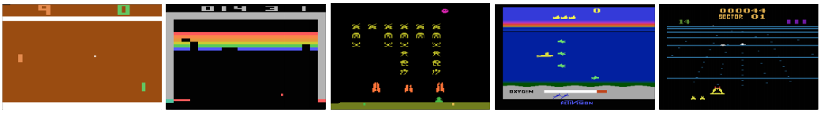
Atari Games
A collection of classic video games that were released for the Atari 2600 home console in the late 1970s and early 1980s.
Now, widely used to train deep reinforcement learning algorithms.

Slide 5
Gymnasium Library
Gymnasium is an open-source tool used to build and test agents in various environments, including classic Atari games.
Deep reinforcement Q-learning is an algorithm used with gymnasium and Atari games to train an agent to maximize its long-term reward.
To use gymnasium and Q-learning to train an agent on an Atari game, we need to define the environment and the agent's actions. Gymnasium provides pre-built environments for many Atari games, such as Space Invaders and Breakout. The agent's actions are typically defined as a set of possible inputs, such as moving left or right or firing the player's weapon.

Slide 6
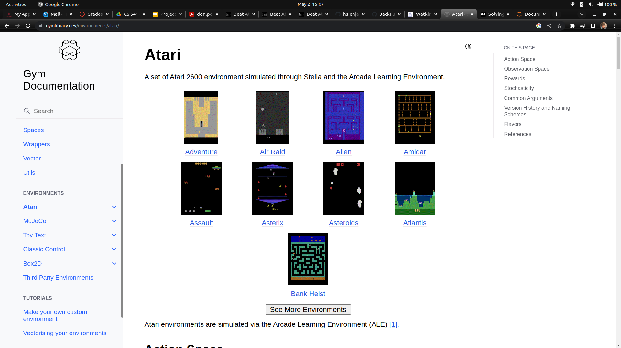
OpenAI Gym is a toolkit for developing and comparing reinforcement learning algorithms. It provides a suite of environments, including Atari games, to test and benchmark RL algorithms.
An important aspect of the gym library is that it provides a benchmark, so that we can compare my learning agent with other learning agents in the same environment and the standardization provides reproducibility of the task, which allows us to compare the results with other implementations.

Slide 7
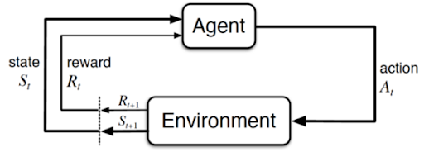
Introduction to Reinforcement Learning
Reinforcement Learning
Reinforcement learning (RL) is the technique where an agent learns to achieve rewards r through interactions with its environment.
In our project we are trying to implement a RL algorithm capable of learning how to play the Atari breakout game.
Using reinforcement learning we are trying to solve Markov Decision Processes (MDPs).
MDPs is a formal way to talk about a game in terms of states, actions
and rewards.
Defines a mechanism of how certain states & agent’s actions lead to other states.
MDP Model

Slide 8
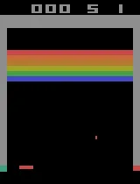
Introduction to Reinforcement Learning
State
A state is the current situation the agent is in.
Good approximation of a state in the Atari game is the current frame.
From a single frame its difficult to determine the motion of the ball (Up! Or Down!).
To avoid violating the Markov property (history does not matter) we make use of multiple frames through which we learn about the speed of objects and infer its acceleration.

Slide 9
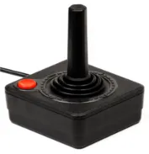
Introduction to Reinforcement Learning
Action
Command given to reach certain state or reward.
Breakout actions are performed with the joystick (doing nothing, asking for ball, left, right).
Reward
Rewards are given after an action is performed.
Calculated based on starting state, action performed, and end state.
In the Breakout game, rewards correspond to changes in score.

Slide 10
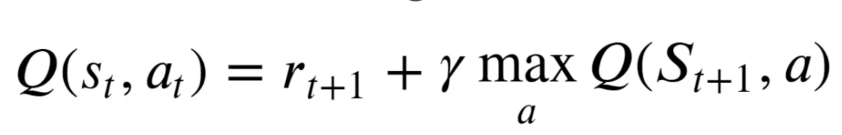
Q-Learning Algorithm
Chris Watkins in 1989 did his PhD Thesis “ Learning from Delayed Rewards” later know as Q-Learning
In his general findings it found to be reinforcement learning as a form of incremental dynamic programming
Later in 2014, DeepMind patented an application of Q-learning to Deep Reinforcement learning

Slide 11
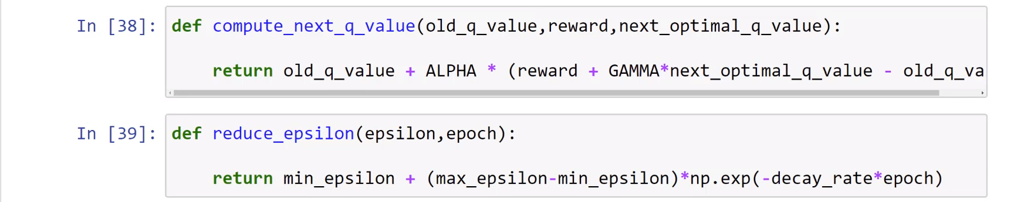
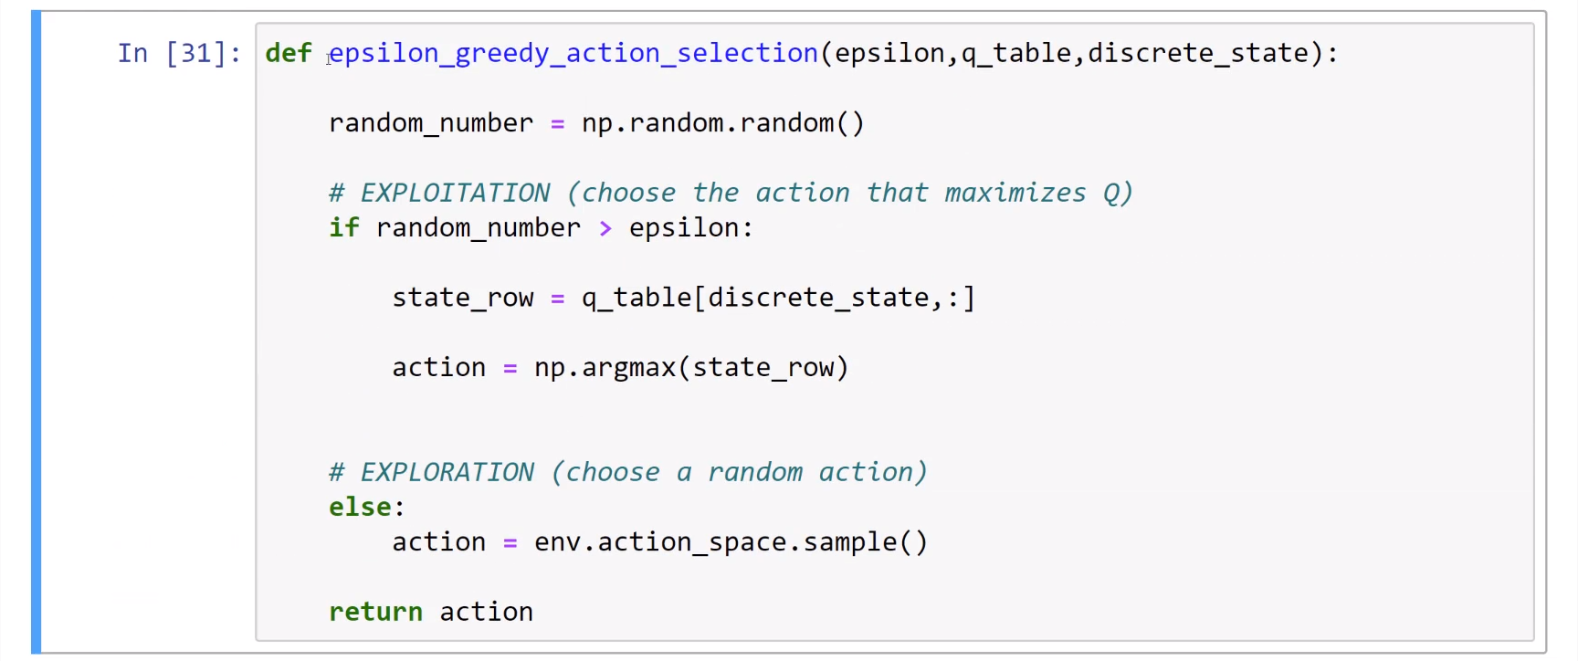

Slide 12
Preprocessing
First, the raw frames are preprocessed by converting their RGB representation to gray-scale, reducing the number of color channels to one. Additionally, the frames are down-sampled to a 110×84 image, further reducing the data size.
Next, since the scale of scores varies greatly from game to game, we fixed all positive rewards to be 1 and all negative rewards to be −1, leaving 0 rewards unchanged.
This step clips the rewards, limiting the scale of the error derivatives and making it easier to use the same learning rate across multiple games.
This can make reinforcement learning more efficient and essential for scaling up reinforcement learning algorithms to more complex environments.

Slide 13
DQN Model Definition
The input to the network is an 84×84×4 (in our case, 110x80x4) image.
The first hidden layer convolves 16 8×8 filters with stride 4 with the input image and applies a rectifier nonlinearity (ReLU).
The second hidden layer convolves 32 4×4 filters with stride 2 and applies a rectifier nonlinearity (ReLU).
The final hidden layer is fully-connected and consists of 256 rectifier units. This layer performs a non-linear transformation on the output of the second hidden layer.
The output layer is a fully-connected linear layer with a single output for each valid action. This layer predicts the Q-value for each possible action in the current state.

Slide 14
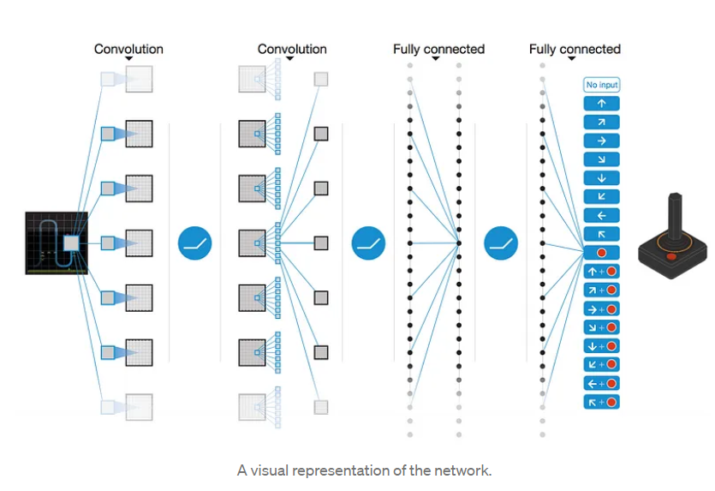

Slide 15
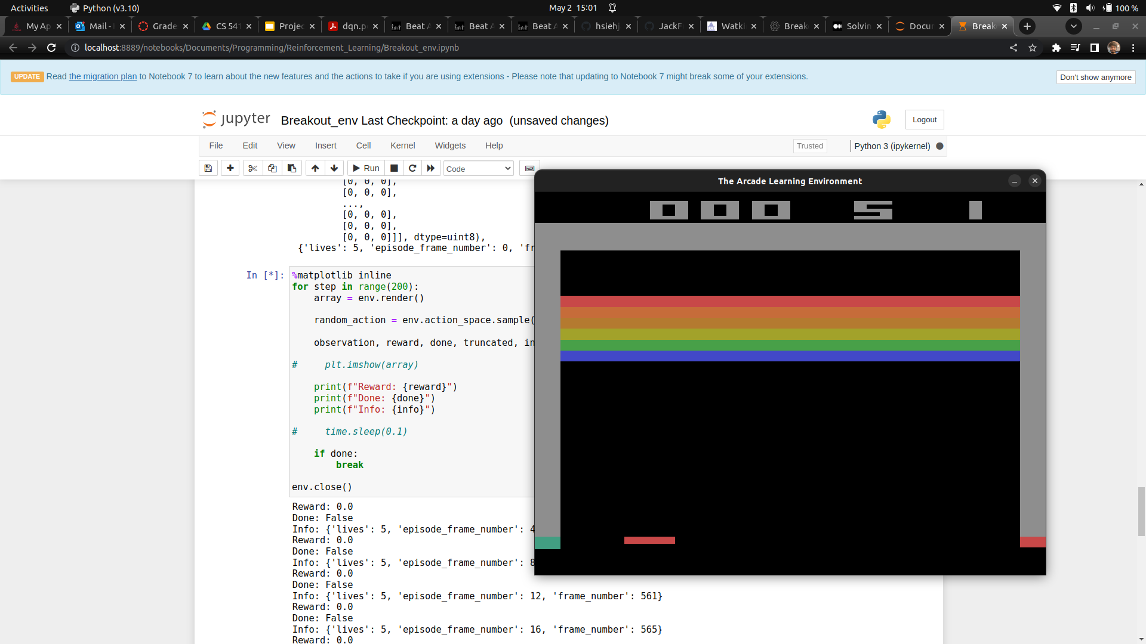
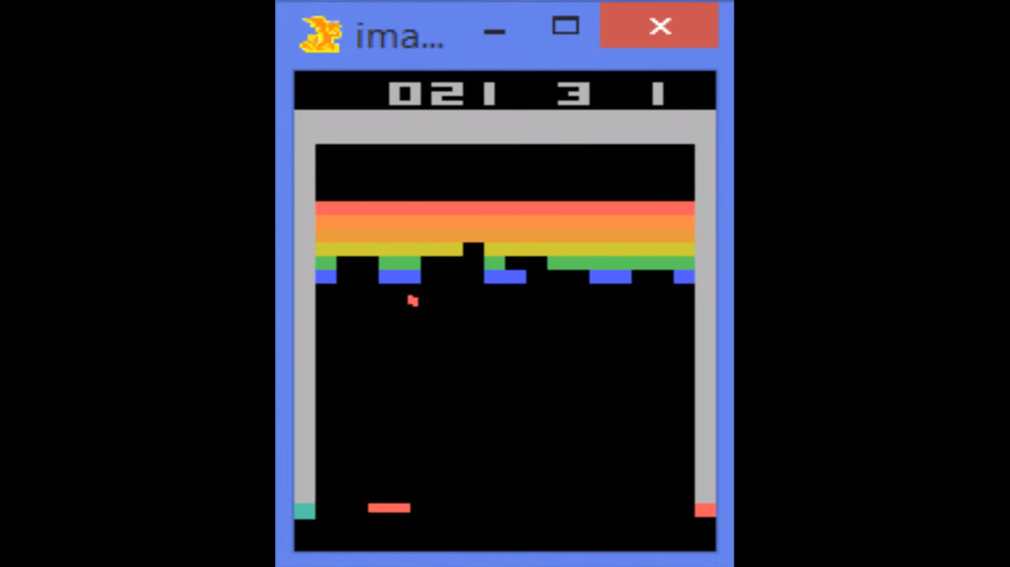
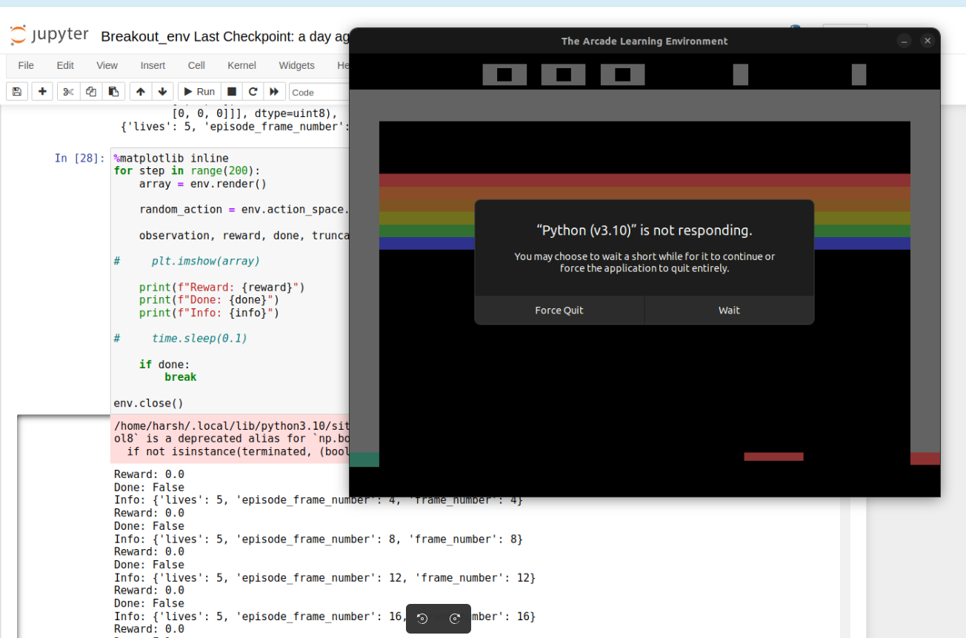
Results

Slide 16
Thank You!

